Slide 1
Syntax and Semantics for FOPL
Prof. Dr. A K M Akhtar Hossain
Dept. of CSE , University of Rajshahi

Slide 2
*****FOPL (First Order Predicate Logic)
FOPL was developed by logicians to extend the expressiveness of PL.
The syntax for FOPL, like PL, is determined by the allowable symbols and rules of combination.
The semantics of FOPL are determined by interpretations assigned to predicates, rather than propositions.

Slide 3
FOPL stands for First Order Predicate Logic. It is one where the quantification is over simple variables and variables can appear only inside a predicate. It permits reasoning about world entities , functions and relations. It also used to assets logical reasoning.
Features of FOPL :
More expressive and powerful representation.
Allows us to represent almost any english sentences.
Generalization of propositional logic.

Slide 4
Syntax of FOPL
The symbols and rules of combination permitted in FOPL are defined as follows:
Connectives: There are five connective symbols:
~(not or negation)
& (and or conjunction)
V (or or inclusive disjunction)
→ (implication)
↔ (equivalence or if and only if).

Slide 5
Syntax of FOPL
Quantifiers: The two quantifier symbols are ∃ ( existential quantification) and ∀ (universal quantification).
Where (∃x) means for some x or there is an x .
and (∀x) means for all x.
When more than one variable is being quantified by the same quantifier, such as, (∀x) (∀y) (∀z), we abbreviate with a single quantifier and drop the parentheses to get ∀xyz.

Slide 6
Syntax of FOPL
Constants: Constants are fixed-value terms that belong to a given domain of discourse.
They are denoted by numbers, words, and small letters near the beginning of the alphabet.
Examples: a , b , c , 5.256, -67, -75.65 , flight-305, john, , Marina, etc.

Slide 7
Syntax of FOPL
Variables: Variables are terms that can assume different values over a given domain.
They are denoted by words and small letters near the end of the alphabet.
Examples: aircraft-type, individuals, x, y, and z.

Slide 8
Syntax of FOPL
Functions: Function symbols denote relations defined on a domain D. They map n elements (n≥0) to a single element of the domain.
Symbols f , g, & h, and words such as father-of , or age-of, represent functions.
An n place (n-ary) function is written as f(t₁, t₂, t₃, .. .. .. t_{n}) where the t_{i} are terms (constants, variables, or functions) defined over some domain. A 0-ary function is a constant.

Slide 9
Syntax of FOPL
Predicates: Predicate symbols denote relations or functional mappings from the elements of a domain D to the values true or false.
Capital letters and capitalized words such as P, Q, R, EQUAL, and MARRIED are used to represent predicates.

Slide 10
Syntax of FOPL
Like functions, predicates may have n (n ≥ 0) terms for arguments written as P(t₁, t₂, t₃, .. .. .., t_{n})
Where the terms t_{i} , i =1 , 2, 3, .. .. .. , n are defined over some domain.
A 0-ary predicate is a proposition, that is, a constant predicate.

Slide 11
Syntax of FOPL
Constants, variables, and functions are referred to as terms, and predicates are referred to as atomic formulas or atoms for short.

Slide 12
*****Syntax of FOPL
Examples:
E1: All employees earning $ 1400 or more per year pay taxes.
E2: Some employees are sick today.
E3: No employee earns more than the president.

Slide 13
Syntax of FOPL
To represent such expressions FOPL, we must define abbreviations for the predicates and functions.
E(x) for x is an employee.
P(x) for x is president.
i(x) for the income of x (lower case denotes a function).
GE(u,v) for u is greater than or equal to v.
S(x) for x is sick today.
T(x) for x pays taxes.

Slide 14
Syntax of FOPL
Using the above abbreviations, we represent E1, E2, and E3 as:
E1: ∀x ((E(x) & GE(i(x),1400)) →T(x))
E2: ∃y (E(y) →S(y))
E3: ∀xy ((E(x) & P(y)) → ~GE(i(x),i(y)))

Slide 15
Syntax of FOPL
An atomic formula is a wffs (well-formed formulas) .
If P and Q are wffs, then ~P, P & Q, P V Q, P
P↔Q, ∀x P(x), and ∃x P(x) are wffs.
Wffs are formed only by applying the above rules a finite number of times.
The above rules state that all wffs are formed from atomic formulas and the proper application of quantifiers and logical connections.

Slide 16
Syntax of FOPL
Some examples of valid wffs are
MAN(john)
PILOT(father-of(bill))
∃ xyz((FATHER(x,y)&FATHER(y,z)) →GRANDFATHER(x,z))
∀x NUMBER(x) →(∃y GREATER-THAN(y,x))

Slide 17
Syntax of FOPL
Some examples of statements that are not wffs are:
∀P P(x)→Q(x)
/* Universal quantification is applied to the predicate P(x). This is invalid in FOPL. */
MAN(~john)
/*The expression is invalid since the term John, a constant, is negated. */
father-of(Q(x))
/* The expression is invalid due to it is function with a predicate argument. */
MARRIED(MAN,WOMAN)
/* The expression fails since it is predicate with two predicate arguments.*/

Slide 18
Semantics for FOPL
When considering specific wffs, we always have in mind some domain D. If not stated explicitly, D will be understood from the context.
The arguments predicates must be terms (constant, variables or functions). Therefore, the domain of each n-place predicate is also defined over D.

Slide 19
Semantics for FOPL
For Example, our domain might be all entities that make up the Computer Science & Engineering Department at the University of Rajshahi.
In this case, constants would be Professors (Dell, Cooke, Gelfond, and so on), Staff (Martha, Pat, Linda and so on), books, labs, offices and so forth.

Slide 20
Semantics for FOPL
The functions we may choose might be advisor-of(x), lab-capacity(y), dept-grade-average(z), and the predicates MARRIED(x), TENURED(y), COLLABORATE(x,y) to name a few.
When an assignment of values is given to each term and to each predicate symbol in a wff, we say an interpretation is given to the wff.

Slide 21
Semantics for FOPL
If the truth values for two different wffs are the same under every interpretation, they are said to be equivalent.
A predicate (or wff) that has no variables is called a ground atom.

Slide 22
Semantics for FOPL
For example, the predicate P(x) in ∀x P(x), is true only if it is true for every value of x in the domain D.
Likewise, the P(x) in ∃x P(x) is true only if it is true for at least one value of x in the domain.
If the above conditions are not satisfied, the predicate evaluates to false.

Slide 23
Semantics for FOPL
For example, we want to evaluate the truth value of the expression E, where
E: ∀x ((A(a,x) V B(f(x))) & C(x))→D(x)
In this expression, there are four predicates: A, B, C, and D.
The predicate A is a two-place predicate, the first argument being the constant a, and the second argument, a variable x.

Slide 24
Semantics for FOPL
The predicates B, C and D are all unary predicates where the argument of B is a function f(x), and the argument of C and D is the variable x.
Since the whole expression E is quantified with the universal quantifier ∀x, it will evaluate to true only if it evaluates to true for all x in the domain D.

Slide 25
Semantics for FOPL
Thus, to complete our example, suppose E is interpreted as follows: Define the domain D = {1, 2} and from D let the interpretation I assign the following values:
a = 2
f(1) = 2, f(2) = 1
A(2,1) = true, A(2,2) = false
B(1) = true, B(2) = false
C(1) = true, B(2) = false
D(1) = false, D(2) = true

Slide 26
Semantics for FOPL
Using a table such as Table 4.3 we can evaluates E as follows:
. If x = 1, A(2,1) evaluates to true, B(2) evaluates to false, and (A(2,1) V B(2)) evaluates to true. C(1) evaluates to true.
Therefore, the expression in the outer parentheses evaluates to true. Hence, since D(1) evaluates to false, the expression E evaluates to false.

Slide 27
Semantics for FOPL
(b) In a similar way, if x =2, the expression can be shown to evaluate to true.
Consequently, since E is not true for all x, the expression evaluates to false.

Slide 28
Properties of WFFS (well-formed formulas)
As in the case of PL, the evaluation of complex formulas in FOPL can often be facilitated through the substitution of equivalent formulas.
Table 4.3 lists a number of equivalent expressions.
Table 4.4 and Table 4.3 are similar, but there are some notable differences, particularly in the wffs containing quantifiers.

Slide 29
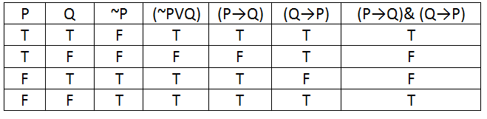
TABLE 4.3 : Truth table for equitant sentences

Slide 30
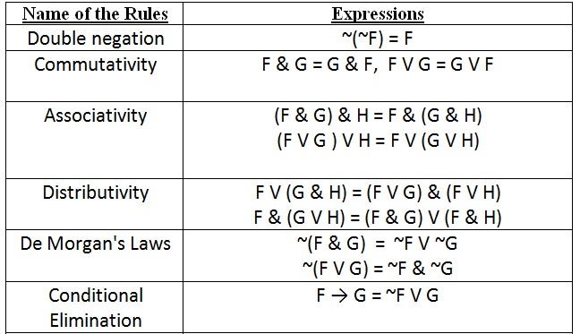
Table 4.4 Equivalent Logical Expressions

Slide 31
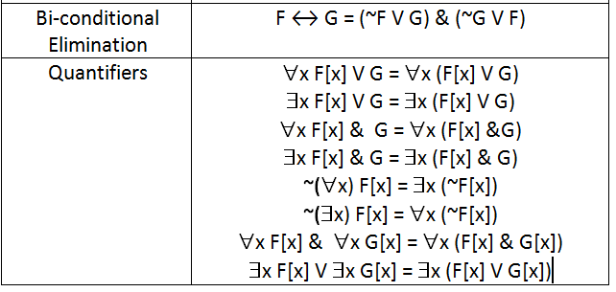
Table 4.4 Equivalent Logical Expressions Cont..

Slide 32
Properties of WFFS
For example, In Table 4.4 attention is called to the last four expressions which govern substitutions involving negated quantifiers and the movement of quantifiers across conjunctive and disjunctive connections.
A wff is said to be valid if it is true under every interpretation.
A wff that is false under every interpretation is said to be inconsistent (or unsatisfiable).

Slide 33
Properties of WFFS
If a wff is not valid, then it is called invalid.
Likewise, a wff that is not inconsistent is satisfiable.
Again, this means that a valid wff is satisfiable and an inconsistent wff is invalid, but the respective converse statements do not hold.

Slide 34
Properties of WFFS
Finally, we say that a wff Q is a logical consequence of the wffs P₁, P₂, P₃, .. .. .. , P_{n} if and only if whenever P₁ & P₂ & P₃ & .. .. .. & P_{n} is true under an interpretation.
Then, Q is also true.

Slide 35
Properties of WFFS
Example :
(a). P &~P is inconsistent and P V ~P is valid since the first is false under every interpretation and the second is true under every interpretation.
(b). From the two wffs
CLEVER(bill) and
∀x CLEVER(x) → SUCCEED(x)

Slide 36
Properties of WFFS
We can show that SUCCEED(bill) is a logical consequence. Thus, assume that both
CLEVER(bill) and ∀x CLEVER(x) → SUCCEED(x)
are true under an interpretation.
Then
CLEVER(bill) → SUCCEED(bill)
Is certainly true since the wff was assumed to be true for all x, including x= bill.

Slide 37
Properties of WFFS
But,
CLEVER(bill) → SUCCEED(bill) = ~ CLEVER(bill) V SUCCEED(bill)
are equivalent and, since CLEVER(bill) is true,
~CLEVER(bill) is false and, therefore, SUCCEED(bill) must be true. Thus, we conclude SUCCEED(bill) is a logical consequence of
CLEVER(bill) and ∀x CLEVER(x) → SUCCEED(x)

Slide 38
CONVERSION TO CLAUSAL FORM
As noted earlier, we are interested in mechanical inference by programs using symbolic FOPL expressions.
One method we shall examine is called resolution.
It requires that all statements be converted into a normalized clausal form.
We define a clause as the disjunction of a number of literals.
A ground clause is one in which no variables occur in the expression.
A Horn clause is a clause with at most one positive literal.

Slide 39
CONVERSION TO CLAUSAL FORM
Clausal Conversion Procedure:
Step 1.: Eliminate all implication and equivalency connectives (Use ~P V Q in place of P → Q and (~P V Q) & (~Q V P) in place of P↔Q).
Step 2: Move all negations in to immediately precede an atom (use P in place of ~(~P), and DeMorgran’s laws, ∃x ~F[x] in place of ~(∀x) F[x] and ∀x ~F[x] in place of ~(∃x) F[x] ).

Slide 40
CONVERSION TO CLAUSAL FORM
Step 3: Rename variables, if necessary, so that all quantifiers have variable assignments; that is, rename variables so that variables bound by a different quantifier.
For example, in the expression
∀x (P(x) → (∃x Q(x)))
rename the second “dummy” variable x which is bound by the existential quantifier to be a different variable, say y, to give
∀x (P(x) → (∃y Q(y))).

Slide 41
CONVERSION TO CLAUSAL FORM
Step 4: Skolemize by replacing all existentially quantified variables with Skolem functions as described above, and deleting the corresponding existential quantifiers.
Step 5: Move all universal quantifiers to left of the expression and put the expression on the right into CNF (Clausal Normal Form).

Slide 42
CONVERSION TO CLAUSAL FORM
Step 6: Eliminate all universal quantifiers and conjunctions since they are retained implicitly. The resulting expressions are clauses and the set of such expressions is said to be in clausal form.
Example: Page No. 64, Patterson

Slide 43
Assignment-3
Determine whether each of the following sentences is (i) satisfiable, (ii) contradictory (iii) valid.
S₁: (P & Q) V ~(P & Q)
S₂: (P V Q) → (P &Q)
S₃: (P & Q) → R V ~Q
S₄: (P V Q) & (P V ~Q) V P
S₅: P → Q → ~P
S₆: P V Q & ~P V ~Q & P

Slide 44
THANKS
THE END

